Slide 1

Tips for Wrestling Parents

Slide 2

Hygiene
Bring an Extra Shirt
Have the kids shower immediately after practice
Bring wipes for Tournaments and meets

Slide 3
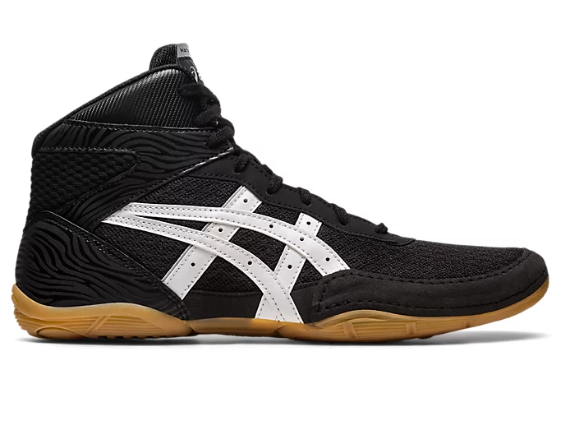
What to bring for Tournaments
Westside Wrestling Merch!!
Food or money for food
Wrestling Shoes
Head Gear

Slide 4
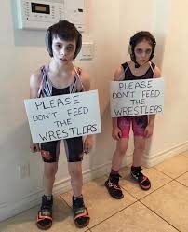
Weight Management
WE DO NOT ENCOURAGE WEIGHT CUTTING!
Weigh with the food
Go for a run or other exercise

Slide 5

Please Come Support!
Come To Meets!!! (And bring Family)
Talk with other parents!!
Talk to Us!!

Slide 6
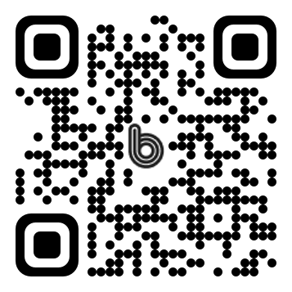
Contact us
Link to the BAND App
(858)717-1003

